Slide 1
A Detailed Look in to Belarus Car Market
By : Team Pattern 6

Slide 2
Agenda
Introducing the Topic
Exploratory Data Analysis
Showcasing the Graphs
Model Building
Evaluation
Questions

Slide 3
Research Proposal
What factors determine the prices of cars in the second hand car market?

Slide 4
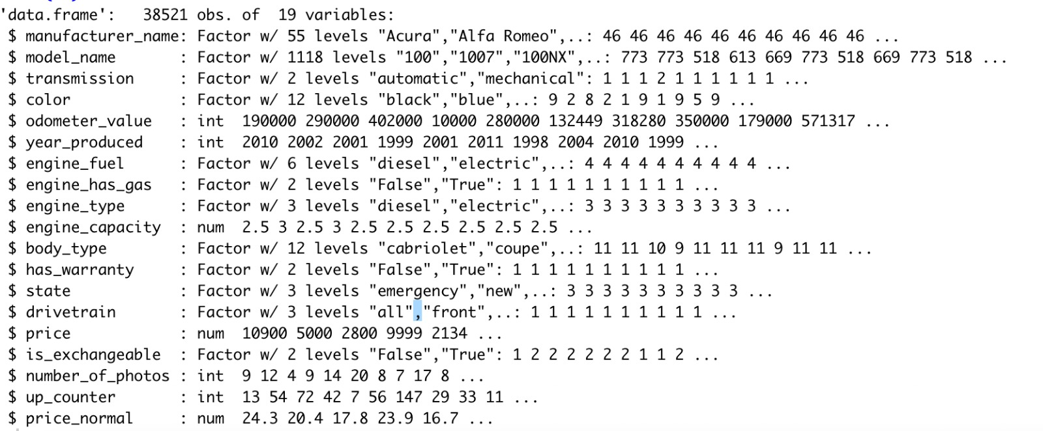
Data Set Information
Dataset contains used car prices for Belarus for the year 2019
a. Source: Kaggle
No. Observations: 38521
No. of variables: 19
Mean : TO BE FILLED
Standard Deviation = TO BE FILLED

Slide 5
INSERT SOME SORT OF FANCY GRAPH
Change text

Slide 6
INSERT SOME SORT OF FANCY GRAPH
No change

Slide 7
Exploratory Data Analysis

Slide 8
EDA Steps
Dropping Null Values : engine_capacity(10)
Name Change: Price USD – Price

Slide 9
Exploring the Graphs
Descriptive Graphs
Gg-Plot(df, aes(price))
Density Test
Correlation Plot(
Q-Q – Normalization
Scatter Plot
Boxplot

Slide 10
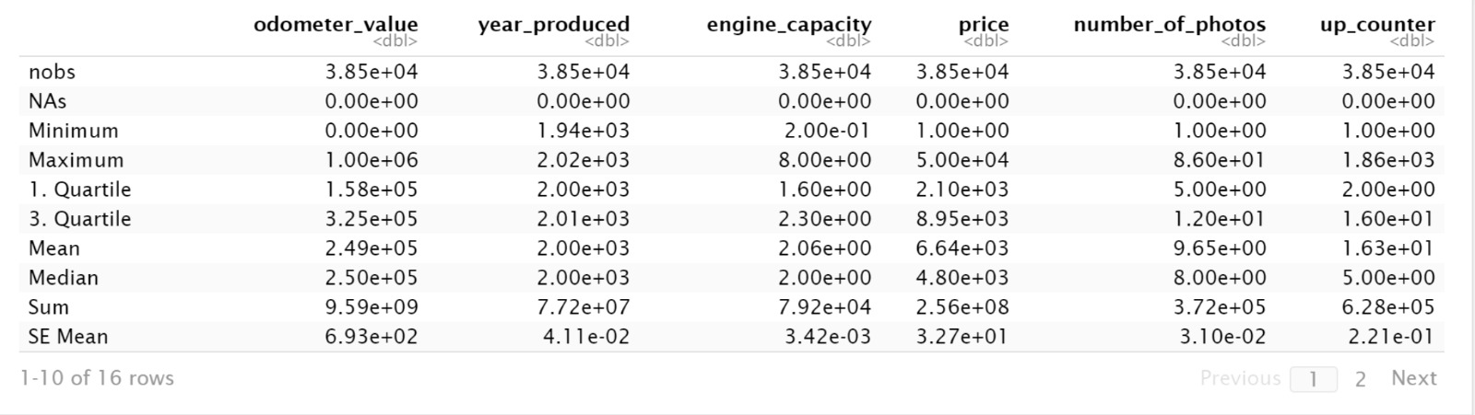
Descriptive – Basic Statistics for the Variables

Slide 11
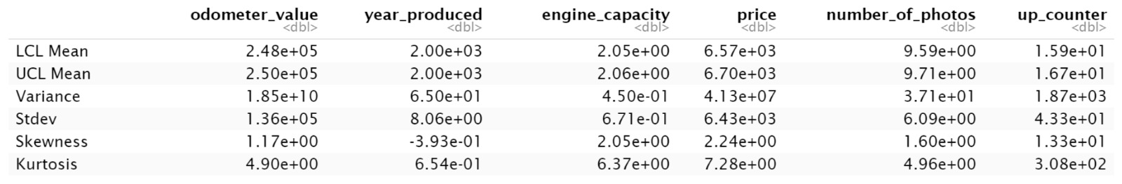
Descriptive – Basic Statistics for the Variables

Slide 12
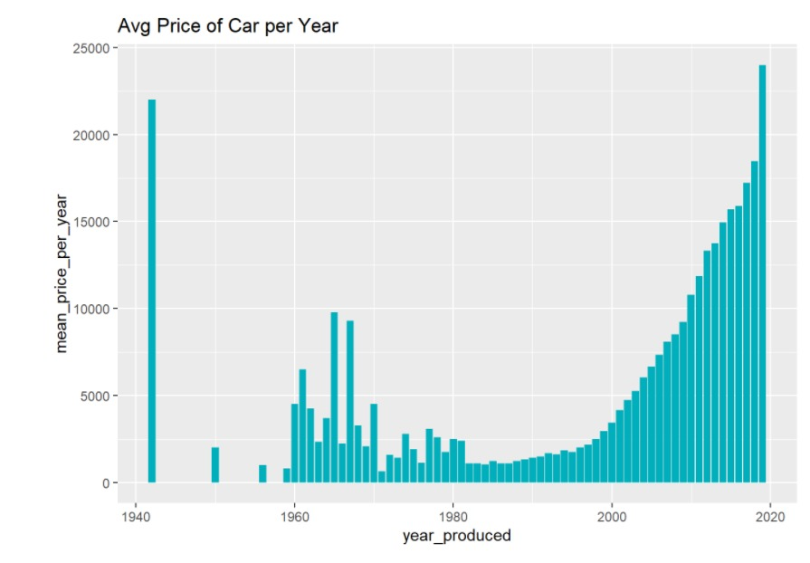
Average Price per Car vs Year Made

Slide 13
Gg-plot

Slide 14
GG Density

Slide 15
Correlation Plot

Slide 16
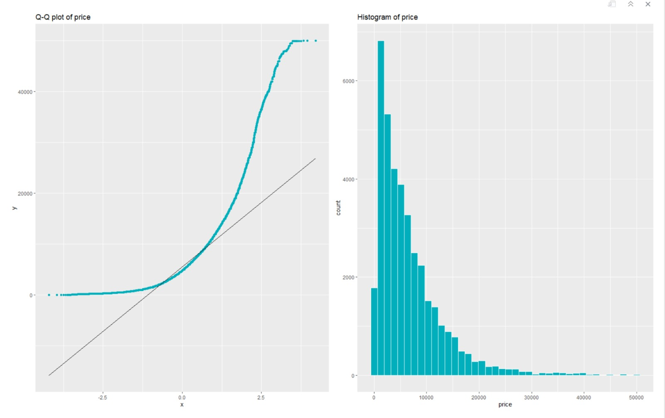
Q-Q Normalization

Slide 17
Scatter Plot

Slide 18
BoxPlot

Slide 19
T - Test

Slide 20
ANOVA

Slide 21
Model Building

Slide 22
Model Building

Slide 23
Model Building

Slide 24
Model Building

Slide 25
Accessibility Guidelines
Use unique slide titles.
Use clear and accurate link text that tells the user where the link takes them.
Add alt-text to images.
Use the accessibility checker to review your presentation.

Slide 26
Accessibility Guidelines
Use unique slide titles.
Use clear and accurate link text that tells the user where the link takes them.
Add alt-text to images.
Use the accessibility checker to review your presentation.

Slide 27
Accessibility Guidelines
Use unique slide titles.
Use clear and accurate link text that tells the user where the link takes them.
Add alt-text to images.
Use the accessibility checker to review your presentation.

Slide 28
Accessibility Guidelines
Use unique slide titles.
Use clear and accurate link text that tells the user where the link takes them.
Add alt-text to images.
Use the accessibility checker to review your presentation.

Slide 29
Accessibility Guidelines
Use unique slide titles.
Use clear and accurate link text that tells the user where the link takes them.
Add alt-text to images.
Use the accessibility checker to review your presentation.

